Slide 1

Fraud Detection
This Photo by Unknown author is licensed under CC BY-SA-NC.

Slide 2
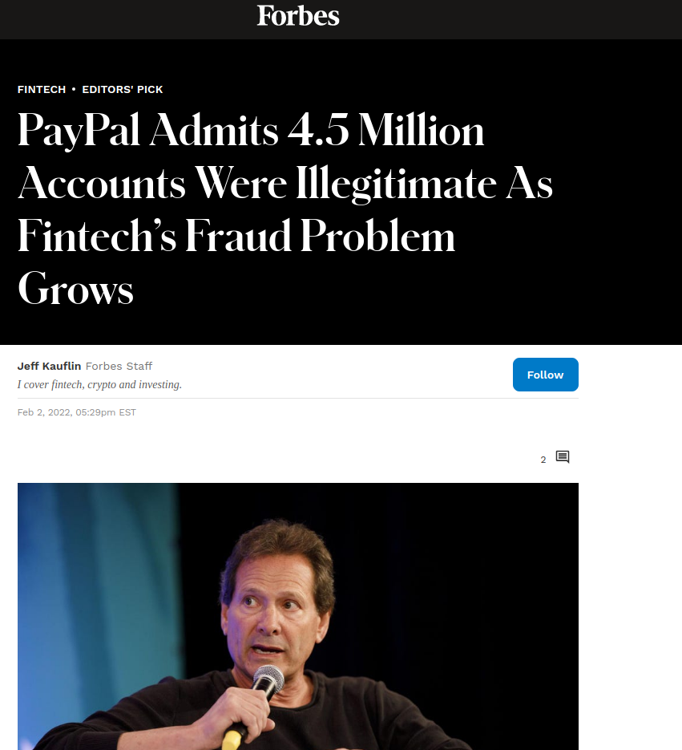

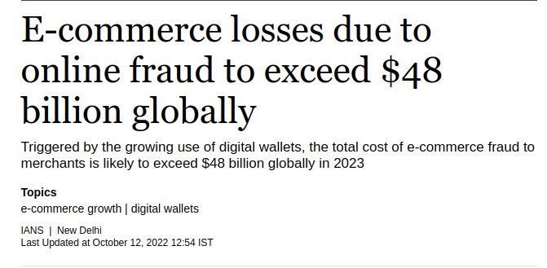
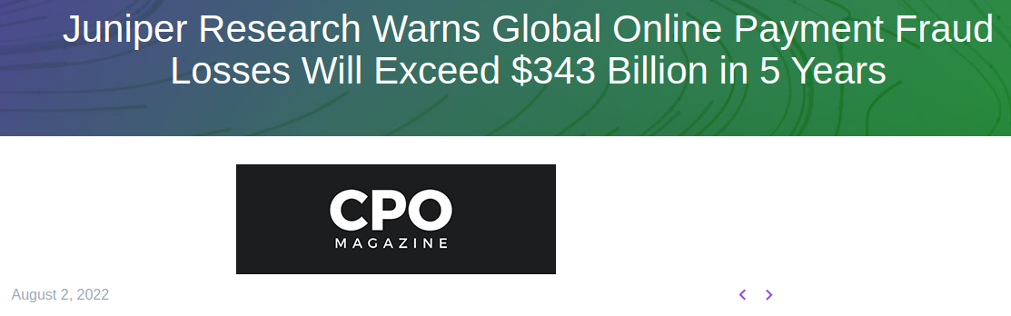
INCREASING NEWS ARTICLES ON ONLINE PAYMENT FRAUD DETECTION

Slide 3

WHY IS IT IMPORTANT
An effective fraud detection system should be able to detect fraudulent transactions with high accuracy and efficiency.
It is necessary to prevent bad actors from executing fraudulent transactions, it is also very critical to ensure genuine users are not prevented from accessing the payments system.
A large number of false positives may translate into bad customer experience and may lead customers to take their business elsewhere

Slide 4

WHY IS IT DIFFICULT
A major challenge in applying ML to fraud detection is presence of highly imbalanced data sets.
. In many available datasets, majority of transactions are genuine with an extremely small percentage of fraudulent ones.
Designing an accurate and efficient fraud detection system that is low on false positives but detects fraudulent activity effectively is a significant challenge

Slide 5

RELEVANT RESEARCH
There is ongoing research in the field and have been applied to detect frauds. The various methods applied are:
Artificial Neural networks
Support vector machines
Markov models
Clustering, etc
This Photo by Unknown author is licensed under CC BY-SA.

Slide 6

DATASET
Dataset of simulated mobile based payment transactions from Kaggle is used.
The dataset contains five categories of transactions labeled as ’CASH IN’, ’CASH OUT’, ’DEBIT’, ’TRANSFER’ and ’PAYMENT
In our experiments we use the following features to train our models.
1) Transaction type
2) Transaction amount
3) Sender account balance before transaction
4) Sender account balance after transaction
5) Recipient account balance before transaction
6) Recipient account balance after transaction

Slide 7
DATA ANALYSIS
The data obtained of TRANSFER and CASH-OUT dataset was broken down into two of its principal components and the data is plotted for fraud and non-fraud classes. It was observed that the fraud and non-fraud classes along two of its principal components were linearly separable. That is, we can use the algorithms logistic regression and linear support vector machines to classify this data.

Slide 8
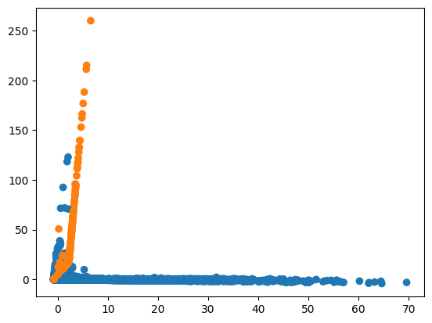
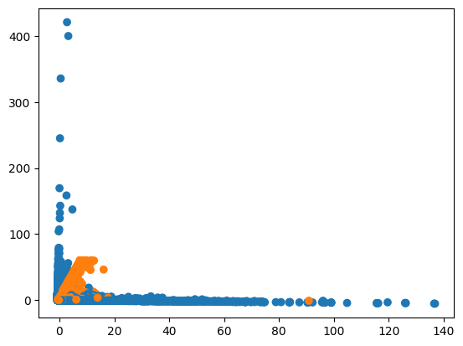
pca1st component vs pca 2nd component of Transfer dataset
pca1st component vs pca 2nd component of cashout dataset

Slide 9

METHODS

Slide 10

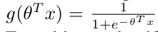
Logistic regression
It is used to classify data with linear decision boundary. It takes in input x, multiplies a weight vector θ. Then it uses the sigmoid function to get the probability of an input belonging to a class(fraud) in binary classification model.
The model has a loss function
J(θ) = -1/m Σ ylog(y') + (1-y)log(1-y')

Slide 11
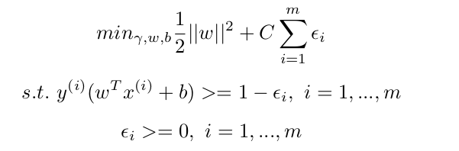
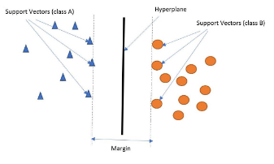
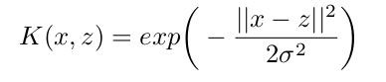
Support vector machines
SVMs are used to create hyperplanes that maximize the margin between the two classes.
To maximize the margins, we have to minimize ||w||. But since we have a soft margin, we minimize
RBF kernels induced in support vector machines induce non-linearity in the decision boundary.
The kernel function for it:

Slide 12
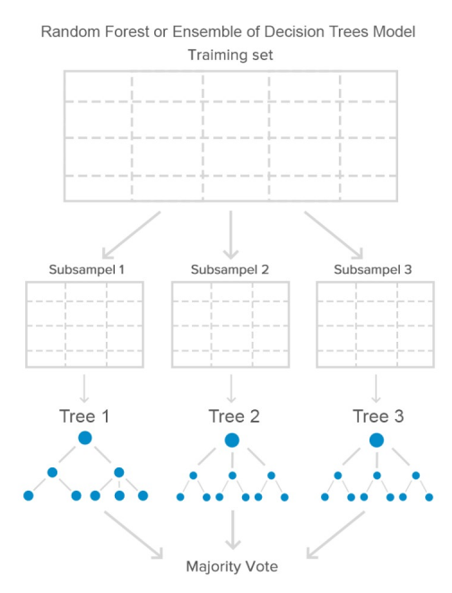
Random FORests
Random forests or random decision forests is an ensemble learning method for classification, regression and other tasks that operates by constructing a multitude of decision trees at training time. For classification tasks, the output of the random forest is the class selected by most trees.

Slide 13
Naïve BAYES
Naïve Bayes is a supervised machine learning algorithm for both classification and regression that works on the concept of naïvetés (independence of attributes) and on the principle of conditional probability defined by Bayes’ theorem.
Our goal is to determine the likelihood of a label given a set of observed features. This probability is written as P (L | features).We can describe this in terms of more directly calculable values by using Bayes’ theorem: P (L | features) = P (features | L)P (L) / P (features) If we are trying to decide between two labels—let’s call them L1 and L2,we compare P (L1 | features) and P (L2 | features)

Slide 14
GraDIENT BOOST DECISION TREES
Gradient boosting decision trees merge a number of weak learners into a single strong learner. Individual decision trees are the weak learners in this situation. The trees are connected in sequence, with each tree attempting to reduce the mistake of the one before it

Slide 15
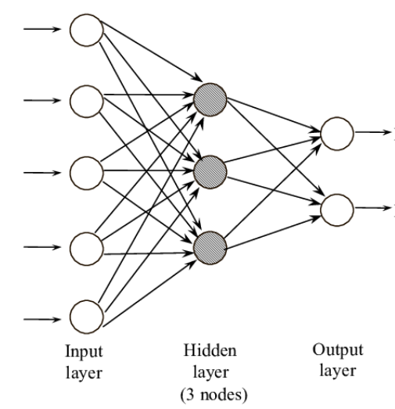
MuLTILAYER PERCEPTRON
Multi layer perceptron is a feedforward neural network that takes a set of input and produces a set of outputs. It uses gradient descent using adam optimizer and cross entropy loss to refine the output. It improves the output with every epoch(a forward pass and a backward pass) and reduces the gap between the actual and predicted output.

Slide 16
A.Dataset split strategy
We divide our dataset based on different transaction types described in dataset section.
In particular, we use TRANSFER and CASH OUT transactions for our experiments since they contain fraud transactions.
For both types, we divide respective datasets into three splits - 70 percent for training,15 percent for CV and 15 percent for testing purposes.
We use stratified sampling in creating train/CV/test splits. Stratified sampling allows us to maintain the same proportion of each class in a split as in the original dataset.

Slide 17

B.MODEL TRAINING AND TUNING
In this system, it is more important to detect a fraud than a false positive. That is, we penalize the misclassifications more. We therefore assign more weights to a fraud than a non-fraud to also counter the data imbalance. For each model we choose weights which give us highest fraud recall with false positives less than 1% in cross validation.

Slide 18
PERFORMANCE EVALUATION
The confusion matrix’s output serves as the primary analytical tool for the vast majority of machine learning classifiers. True Positive (TP), the correctly classified fraudulent cases, False Negative(FN), the incorrectly classified legitimate observations, False Positive (FP), the incorrectly classified legitimate transactions, and True Negative (TN), the correctly classified legitimate observations.
Precision is the ratio of correctly predicted positive occurrences to the total of predicted positive observations. It is written mathematically as Precision = T P/T P + F P
Recall is also the ratio of true positives to the total of true positives and false negatives. It is given mathematically by Recall = T P/T P + F N

Slide 19
F1 measure is defined as the weighted average of precision and recall.It is given mathematically as
f1 Score = 2 ∗ Recall ∗ Precision/Recall ∗ Precision
We chose to plot precision/recall curves (PRC) over ROC as PRCs are more sensitive to misclassifications when dealing with highly imbalanced datasets like ours.

Slide 20

RESULTS

Slide 21
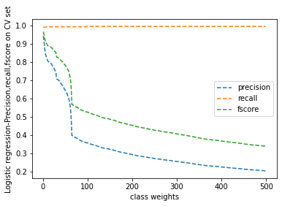
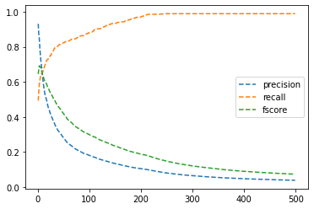
Precision, Recall, Fscore curves for Logistic Regression
Transfer
Cash-out

Slide 22
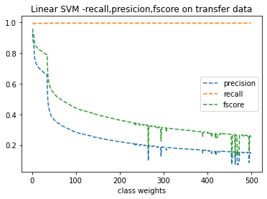
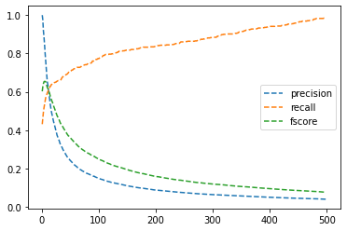
Precision, Recall, Fscore curves for LINEAR SVM
Transfer
Cash-out

Slide 23
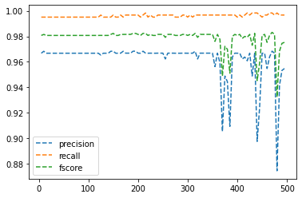
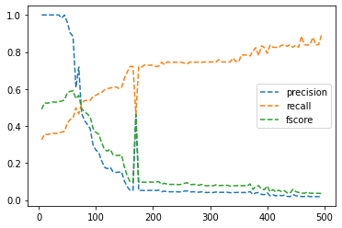
Precision, Recall, Fscore curves for RANDOM FORESTS
Transfer
Cash-out

Slide 24
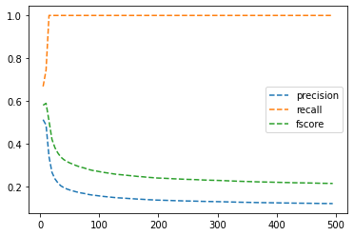
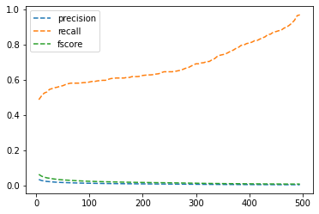
Precision, Recall, Fscore curves for NAÏVE BAYES(GAUSSIAN)
Transfer
Cash-out

Slide 25
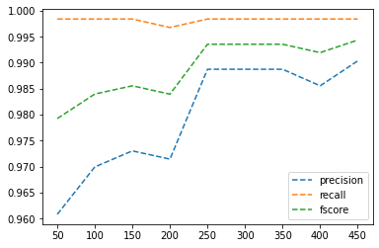
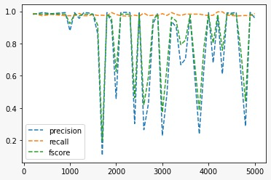
Precision, Recall, Fscore curves for GraDIENT BOOSTING,MLP
Gradient Boosting for transfer
MLP for transfer

Slide 26


WEIGHTS FOR GOOD PRECISION, RECALL FOR VARIOUS MODELS
Transfer
Cash-out

Slide 27
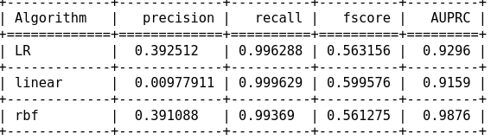
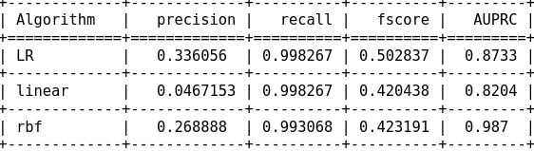
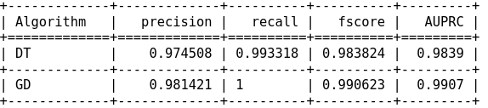
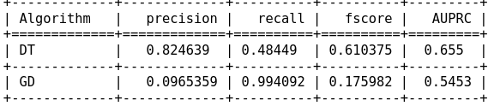
Precision Recall curves
Finally, we made predictions on our test dataset split using the models that were trained using the selected set of class weights. By calculating metrics such as recall, precision, f1 score, and area under the precision-recall curve, we assessed the performance of our models.
Train set of transfer, cashout

Slide 28
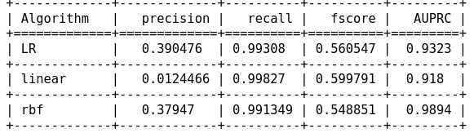
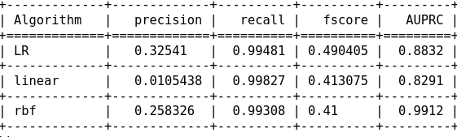
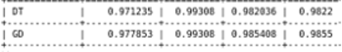
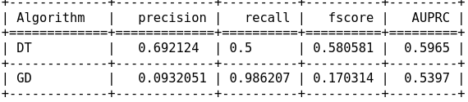
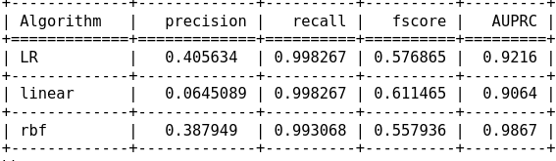
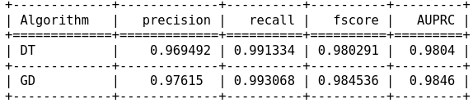
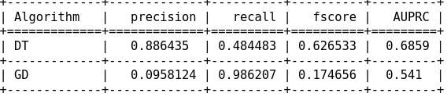
Validation set of transfer, cashout
Test set of transfer, cashout

Slide 29
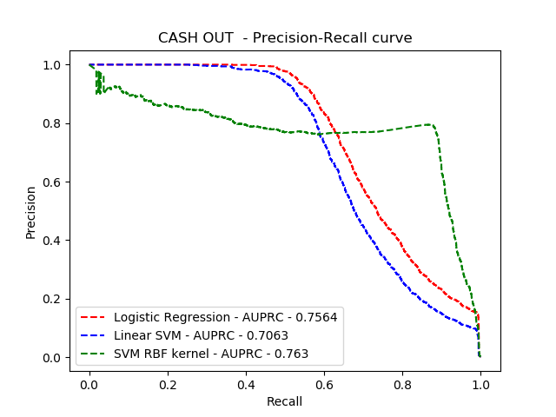
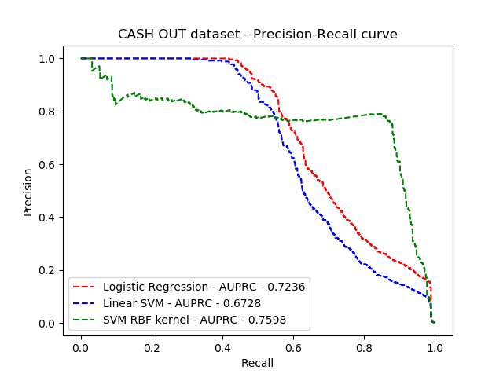
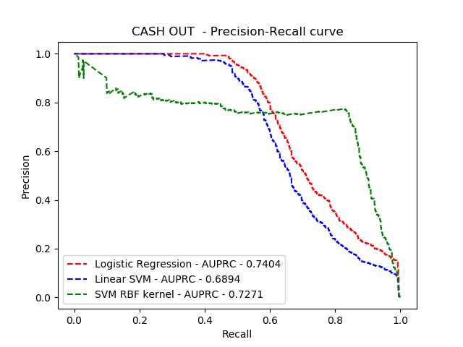
AUPRC Curves
Train, Validation, Test datasets of cashout

Slide 30
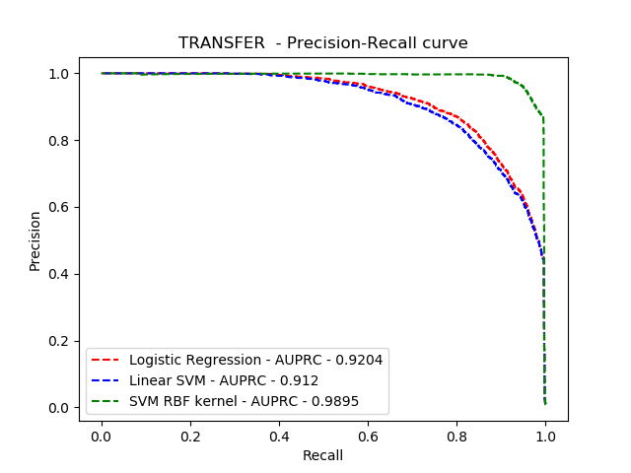
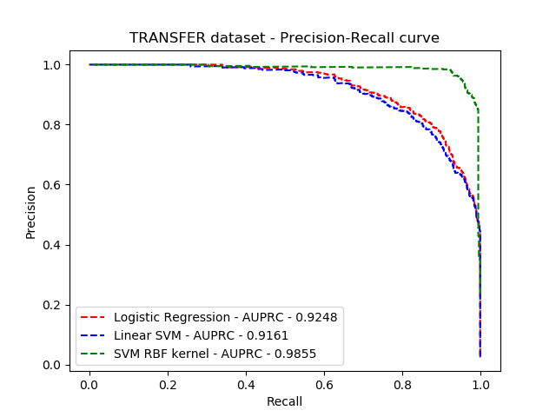
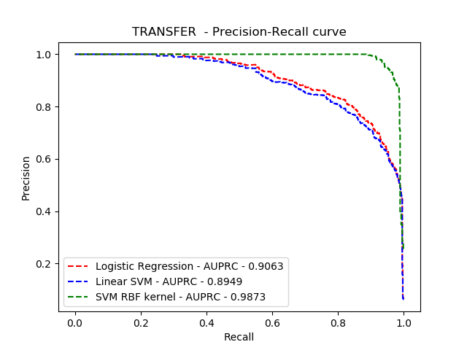
Training, Validation, Test splits on Transfer

Slide 31
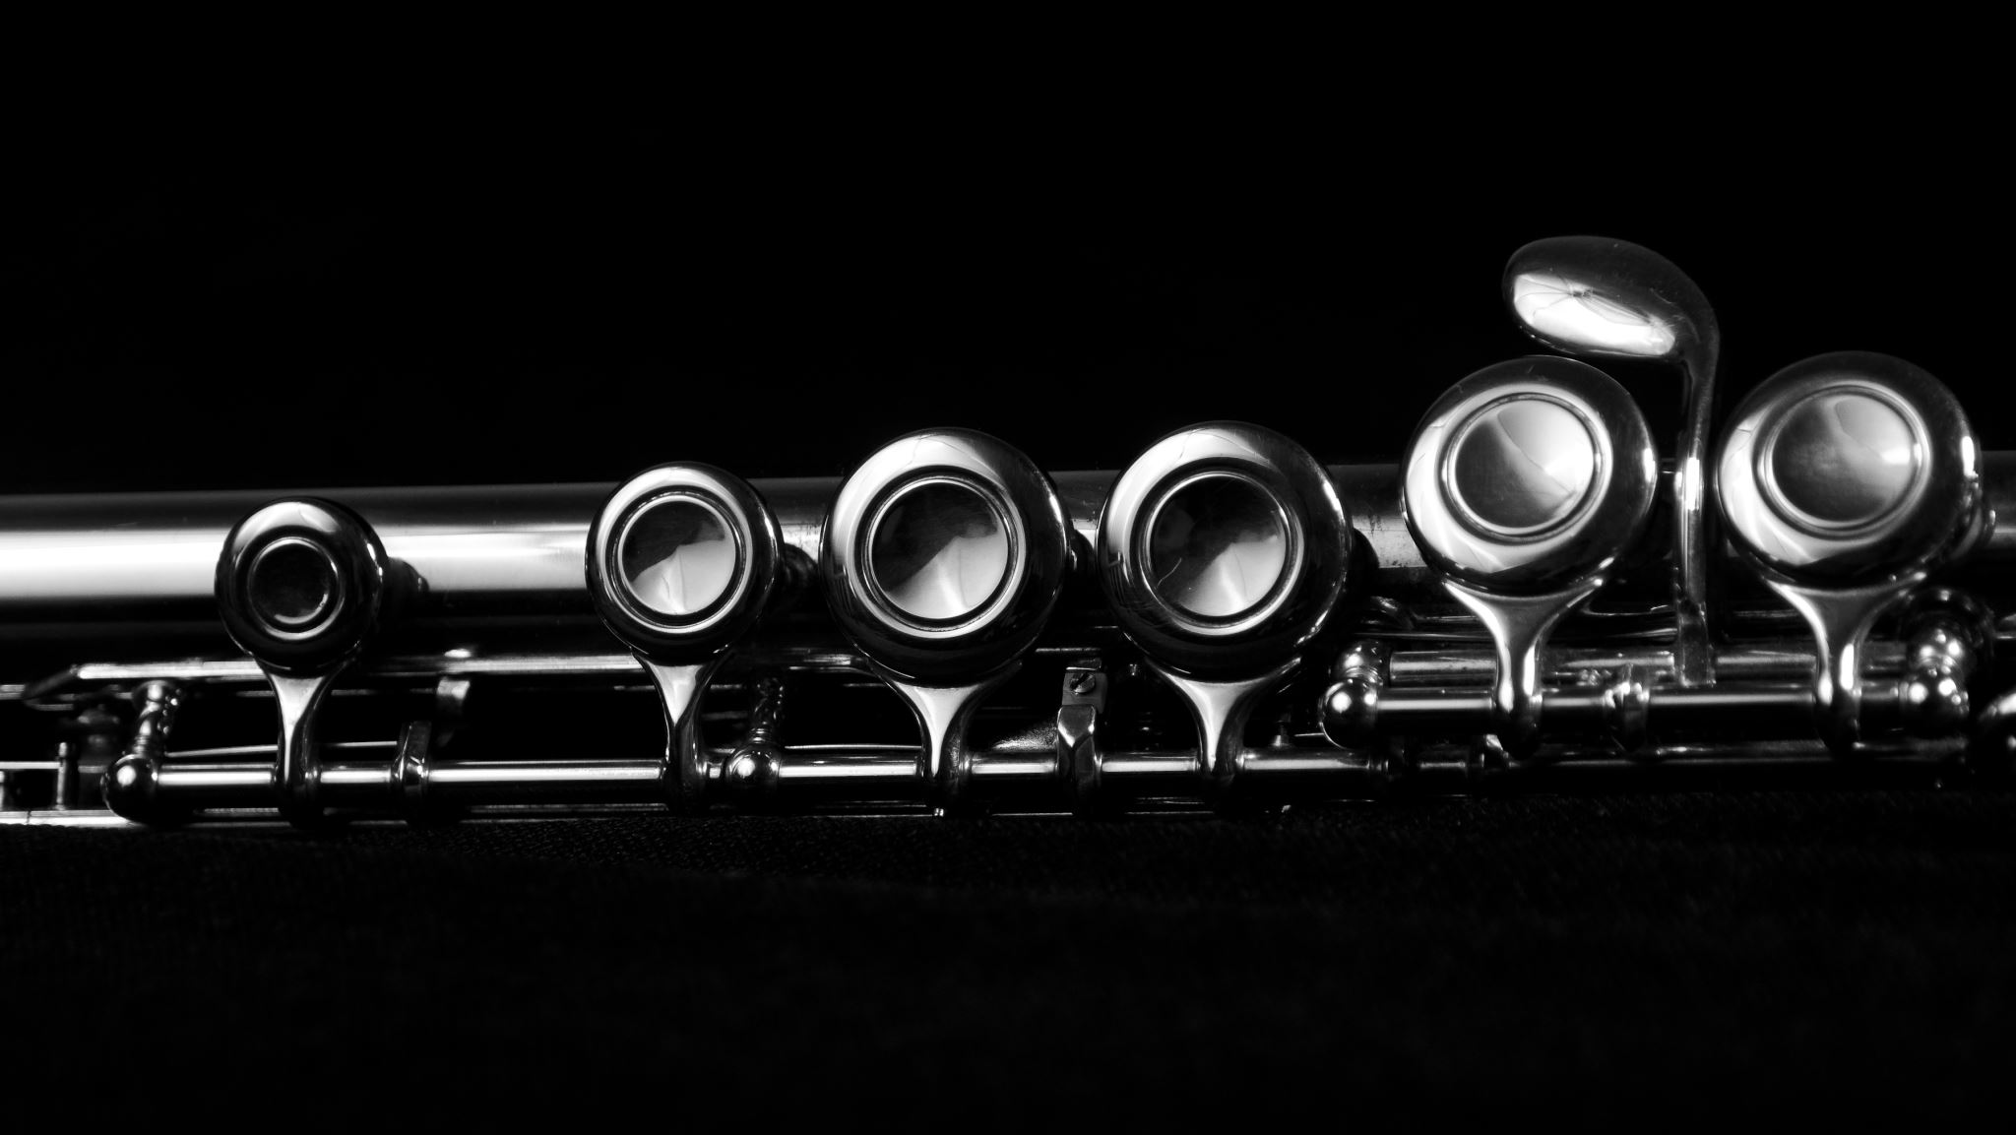
CONCLUSIONS

Slide 32
In this study, we conducted tests to compare how well Logistic Regression, Gradient Boosted Decision Tree (tree-based), Random Forests, Support Vector Machine (linear,kernel-based) , mlp algorithms performed at predicting fraud in Mobile Money transactions, which is a common problem in developing nations.
Accuracy, precision, recall, and F1-Score, which are regarded as fairly strong measures for assessing the effectiveness of classification algorithms from unbalanced datasets, were used to analyse the experiment findings.
The outcomes of our tests demonstrated that the Random Forests and gradient boosted decision tree can accurately forecast fraudulent transactions.Finally, this is solely a design/business decision in the real world and relies on how many false positives a payments company is willing to accept.

Slide 33



